Slide 1
LSTM-BAYES FOR ASSET PRICING
Presented by Ares Grau

Slide 2
AGENDA
Improvement compared to the baseline
Results

Slide 3
IMPROVEMENT

Slide 4
COMPARISON
STEP | STEP NAME | BAYES | LSTM-BAYES
1 | DATA | same | same
2 | mean_ret, tstat | same | same
3 | mua|log_siga|logit_pa|mub|log_sigb | Single year | - Look at the last four years - Predict the standards for the following year.
4 | Bayes shrinkage: Input: STEP 3 output | Bayes | Bayes
5 | pred_ret | same | same

Slide 5
RESULTS

Slide 6
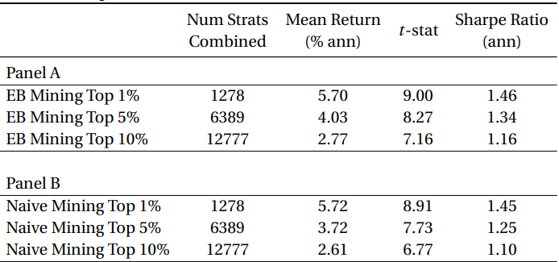
RETURNS OF DATA-MINED LONG-SHORT PORTFOLIOS
 | Num | mean ret | T-stat | Sharpe
EB_LSTM 1% | 1279 | 5.64 | 5.71 | 0.90
EB_LSTM 5% | 6392 | 3.56 | 5.25 | 0.83
EB_LSTM 10% | 12784 | 2.10 | 4.14 | 0.65

Slide 7
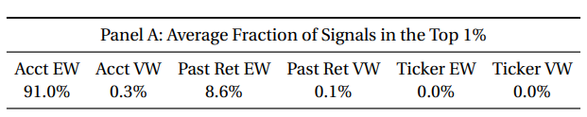
PANEL A: AVERAGE FRACTION OF SIGNALS IN THE TOP 1%
EB
EB-LSTM
Acct EW | Acct VW | Past ret EW | Past ret VW | Ticker EW | Ticker VW
89.3% | 0.2% | 9.7% | 0.8% | - | -

Slide 8
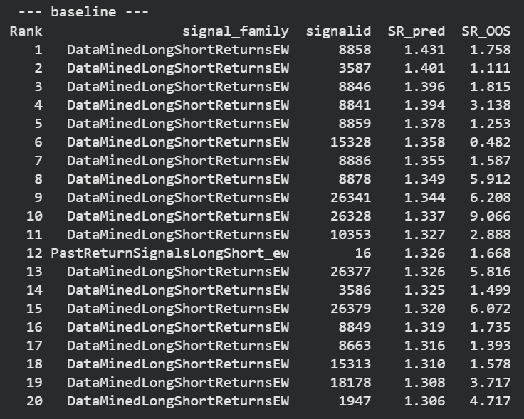
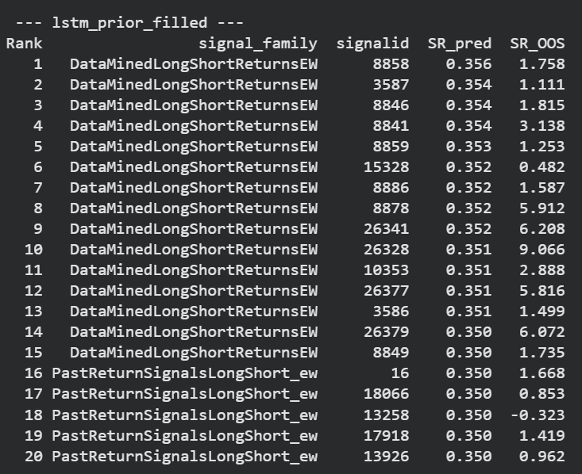
PANEL B: TOP 20 STRATEGIES IN 1994 BASED ON SIGNED PREDICTED SHARPE RATIO

Slide 9
LSTM_BAYES_ATTENTION (V2)
Hidden size = 32
Lookback window = 20
Attention

Slide 10
RETURNS OF DATA-MINED LONG-SHORT PORTFOLIOS
 | Num | mean ret | T-stat | Sharpe
EB_LSTM 1% | 1279 | 5.70 | 6.04 | 0.96
EB_LSTM 5% | 6392 | 3.87 | 5.77 | 0.91
EB_LSTM 10% | 12784 | 2.58 | 5.24 | 0.83

Slide 11
PANEL A: AVERAGE FRACTION OF SIGNALS IN THE TOP 1%
EB
EB-LSTM
Acct EW | Acct VW | Past ret EW | Past ret VW | Ticker EW | Ticker VW
90.9 % | 0.0 % | 8.9 % | 0.0 % | 0.2 % | 0.0 %

Slide 12
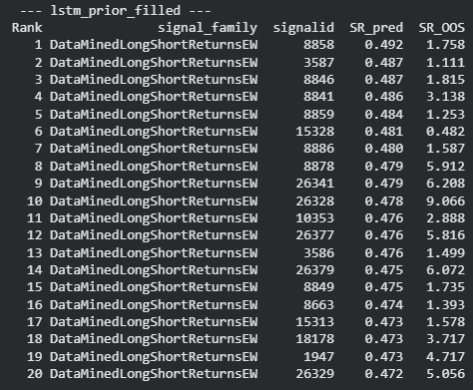
PANEL B: TOP 20 STRATEGIES IN 1994 BASED ON SIGNED PREDICTED SHARPE RATIO

Slide 13
LSTM_BAYES_ATTENTION (V3)
Hidden size = 32
Lookback window = 20
Attention + SHARPE LOSS

Slide 14
RETURNS OF DATA-MINED LONG-SHORT PORTFOLIOS
 | Num | mean ret | T-stat | Sharpe
EB_LSTM 1% | 1278 | 5.53 | 5.96 | 0.97
EB_LSTM 5% | 6389 | 3.80 | 5.65 | 0.92
EB_LSTM 10% | 12777 | 2.61 | 5.13 | 0.83

Slide 15
PANEL A: AVERAGE FRACTION OF SIGNALS IN THE TOP 1%
EB
EB-LSTM
Acct EW | Acct VW | Past ret EW | Past ret VW | Ticker EW | Ticker VW
90.1 % | 0.0 % | 9.6 % | 0.0 % | 0.2 % | 0.0 %

Slide 16
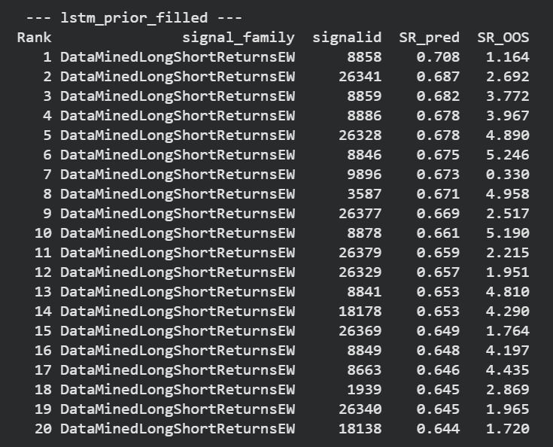
PANEL B: TOP 20 STRATEGIES IN 1994 BASED ON SIGNED PREDICTED SHARPE RATIO

Slide 17
LSTM_BAYES_ATTENTION (V4)
Hidden size = 32
Lookback window = 20
Attention: Multi head
SHARPE LOSS

Slide 18
RETURNS OF DATA-MINED LONG-SHORT PORTFOLIOS
 | Num | mean ret | T-stat | Sharpe
EB_LSTM 1% | 1278 | 5.95 | 6.27 | 1.02
EB_LSTM 5% | 6389 | 3.40 | 3.65 | 0.59
EB_LSTM 10% | 12777 | 1.89 | 2.16 | 0.35

Slide 19
PANEL A: AVERAGE FRACTION OF SIGNALS IN THE TOP 1%
EB
EB-LSTM
Acct EW | Acct VW | Past ret EW | Past ret VW | Ticker EW | Ticker VW
92.0 % | 0.0 % | 5.3 % | 2.7 % | 0.0 % | 0.0 %

Slide 20
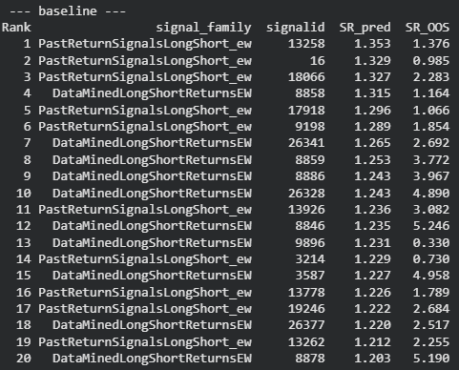
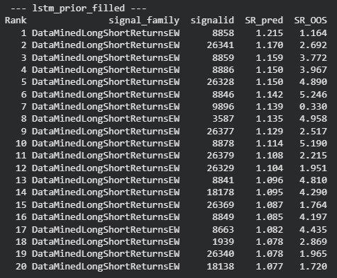
PANEL B: TOP 20 STRATEGIES IN 1999 BASED ON SIGNED PREDICTED SHARPE RATIO

Slide 21
LSTM_BAYES_ATTENTION (V5)
Hidden size = 32
Lookback window = 20
Attention: Multi head

Slide 22
RETURNS OF DATA-MINED LONG-SHORT PORTFOLIOS
 | Num | mean ret | T-stat | Sharpe
EB_LSTM 1% | 1278 | 5.44 | 5.84 | 0.92
EB_LSTM 5% | 6389 | 3.72 | 5.87 | 0.93
EB_LSTM 10% | 12777 | 2.35 | 5.22 | 0.83

Slide 23
PANEL A: AVERAGE FRACTION OF SIGNALS IN THE TOP 1%
EB
EB-LSTM
Acct EW | Acct VW | Past ret EW | Past ret VW | Ticker EW | Ticker VW
93.2 % | 0.1 % | 4.6 % | 0.0 % | 2.1 % | 0.0 %

Slide 24
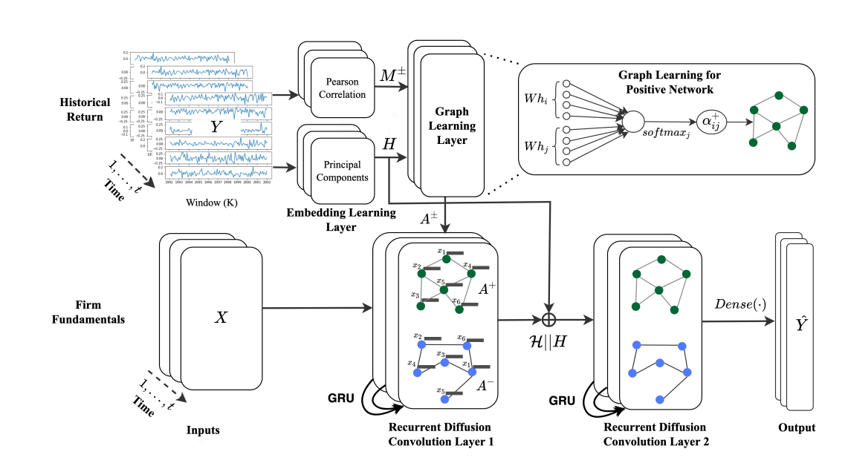
REFERENCE - GRAPH

Slide 25
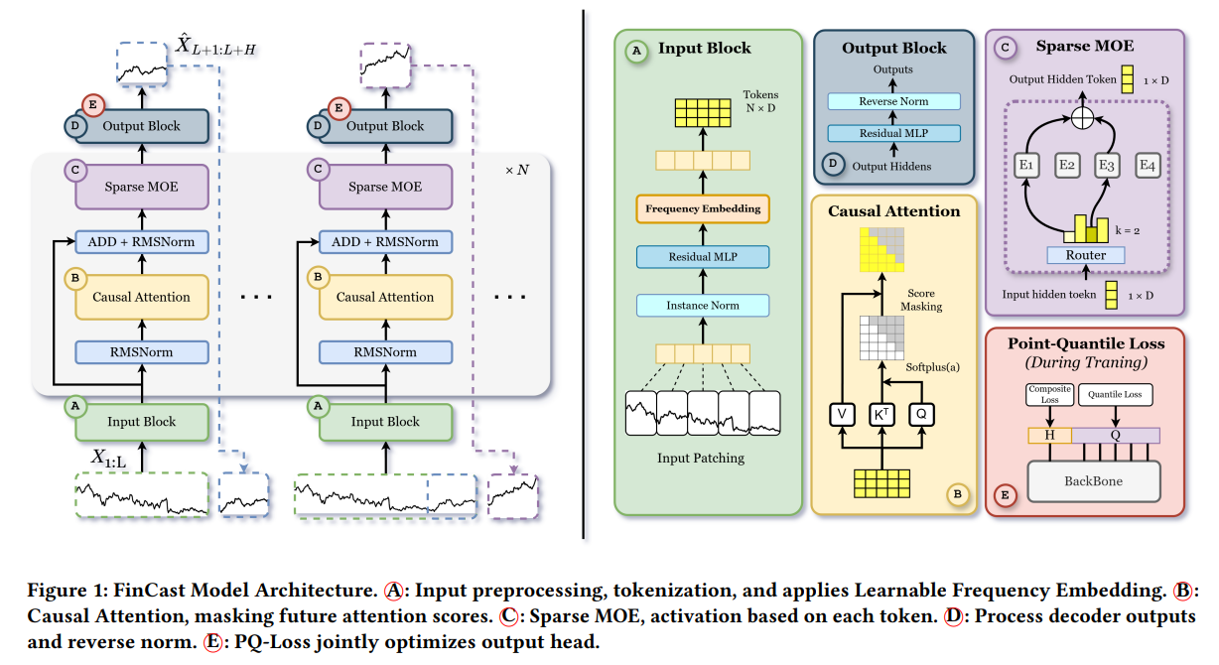
REFERENCE - FINCAST

